Slide 1
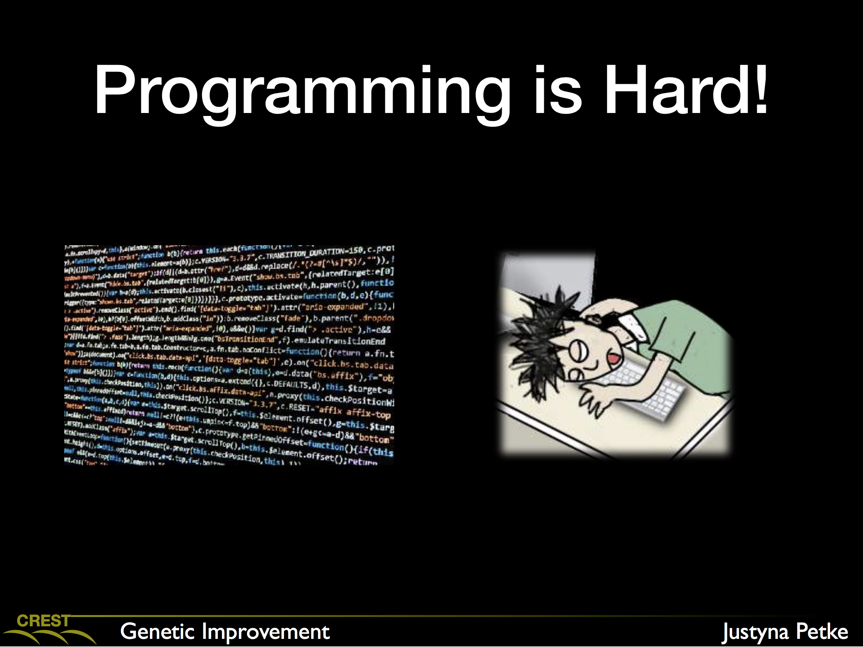
[Recap]
http://phdopen.mimuw.edu.pl/zima15/petke-slides/gi.pdf

Slide 2
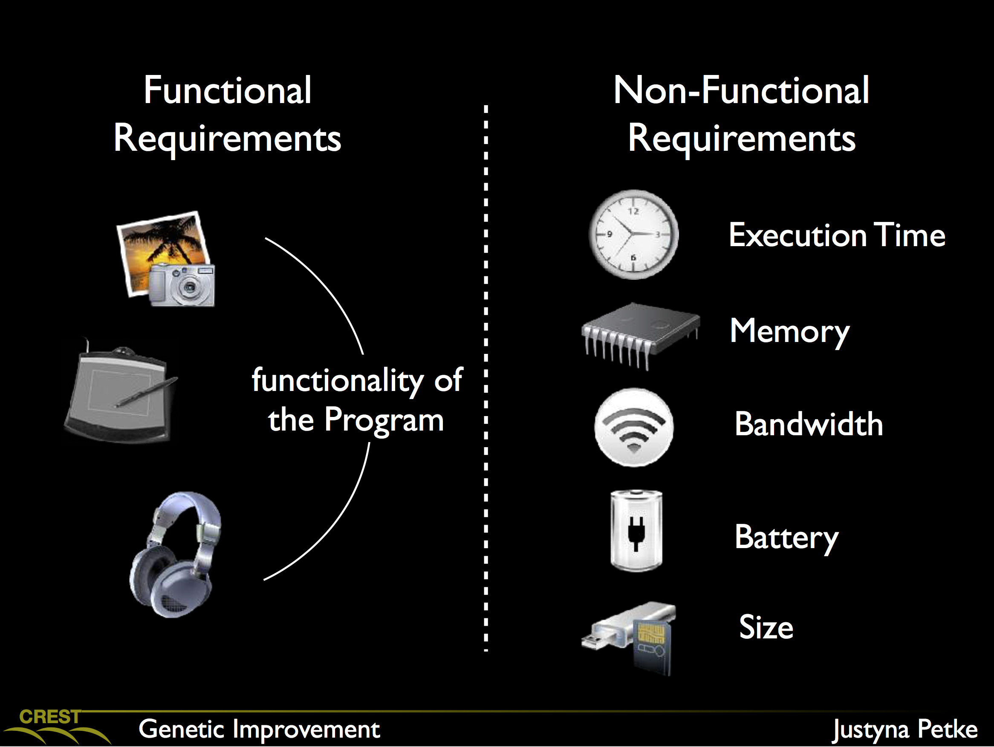
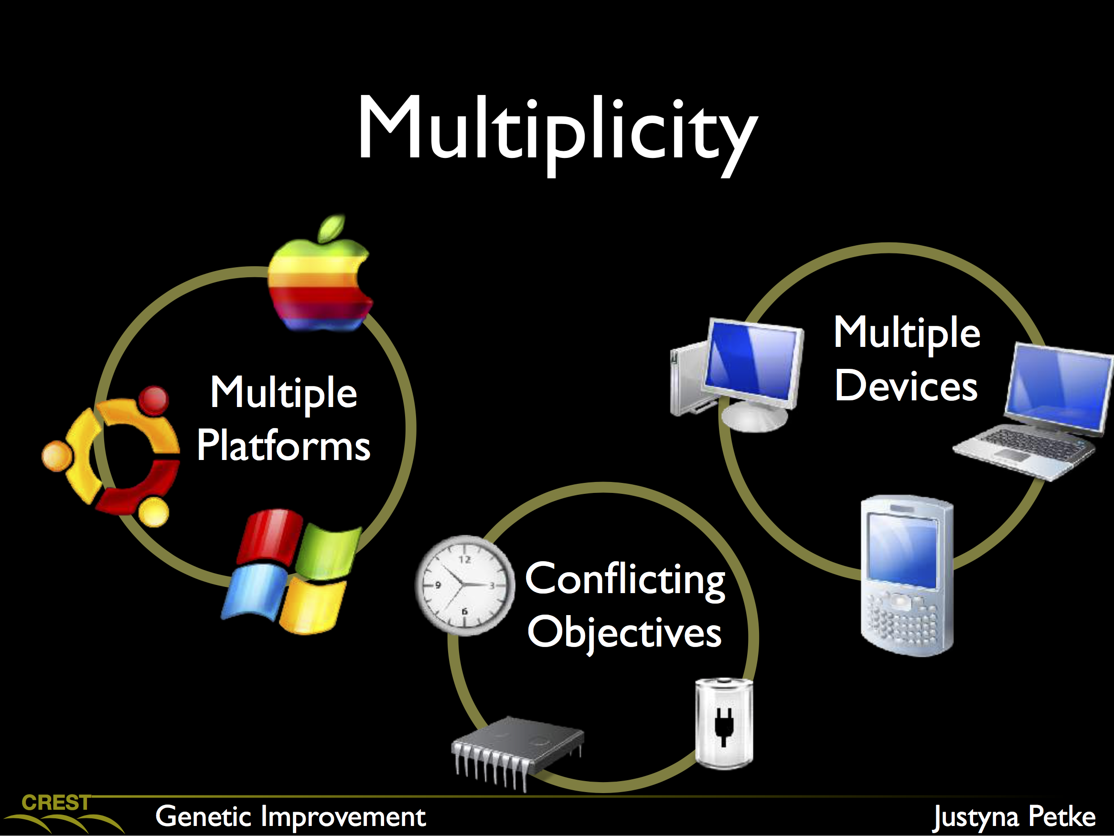
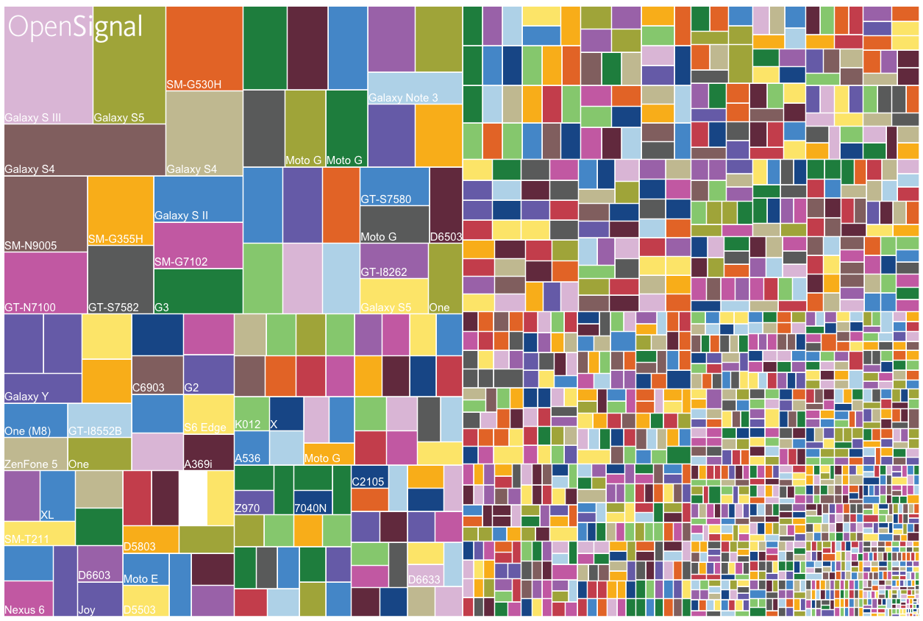
[Recap]
http://phdopen.mimuw.edu.pl/zima15/petke-slides/gi.pdf
Note: over 24,000 different Android phones in 2015
https://qz.com/472767/there-are-now-more-than-24000-different-android-devices/

Slide 3
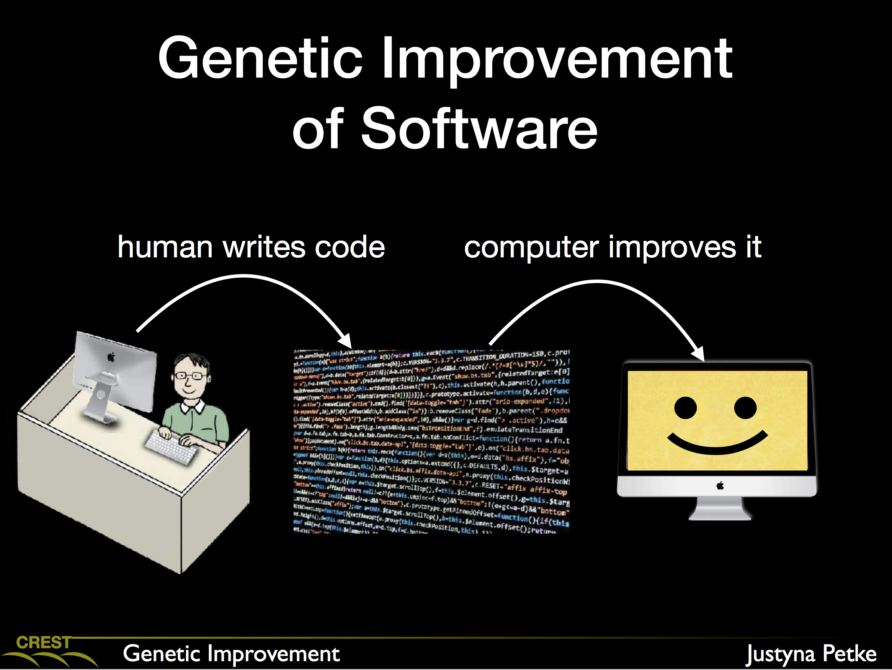
[Recap]
http://phdopen.mimuw.edu.pl/zima15/petke-slides/gi.pdf

Slide 4
Deep Parameter Optimisation on Android Smartphones for Energy Minimisation - A Tale of Woe and a Proof-of-Concept -
Mahmoud A. Bokhari, Bobby R. Bruce (UCL), Brad Alexander and Markus Wagner
Full paper: http://cs.adelaide.edu.au/~markus/pub/2017gecco-deepandroid.pdf

Slide 5
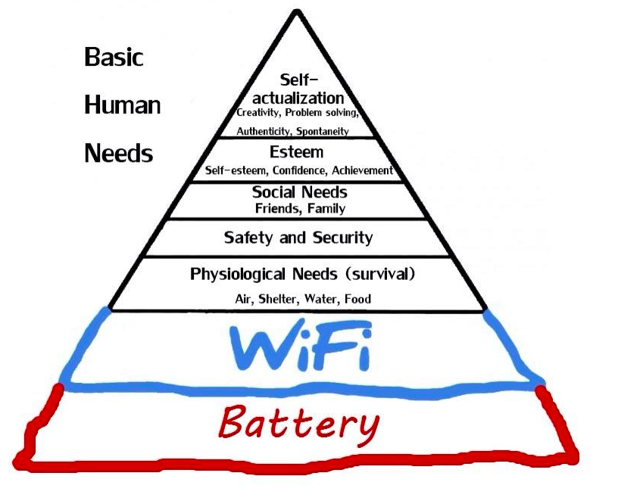
Maslow’s hierarchy of needs
2.0

Slide 6
Maslow’s hierarchy of needs
Photo taken in Malaga, July 2017
© Markus Wagner

Slide 7
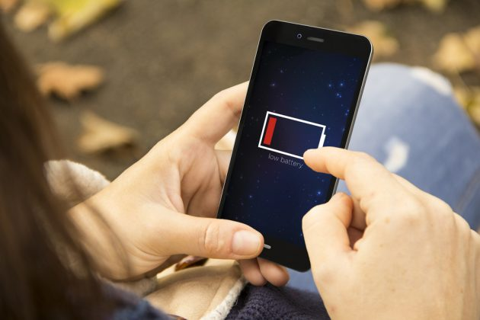
as soon as this appears

Slide 8

shock

Slide 9

anger

Slide 10

denial

Slide 11
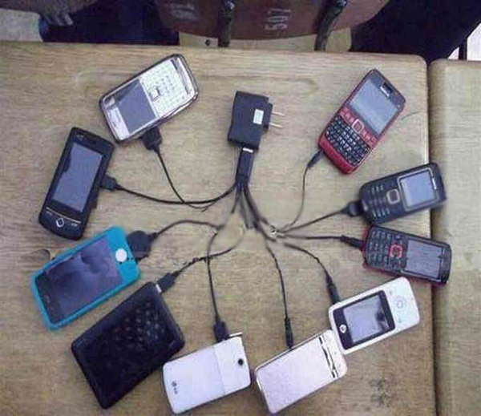
the need to get power

Slide 12
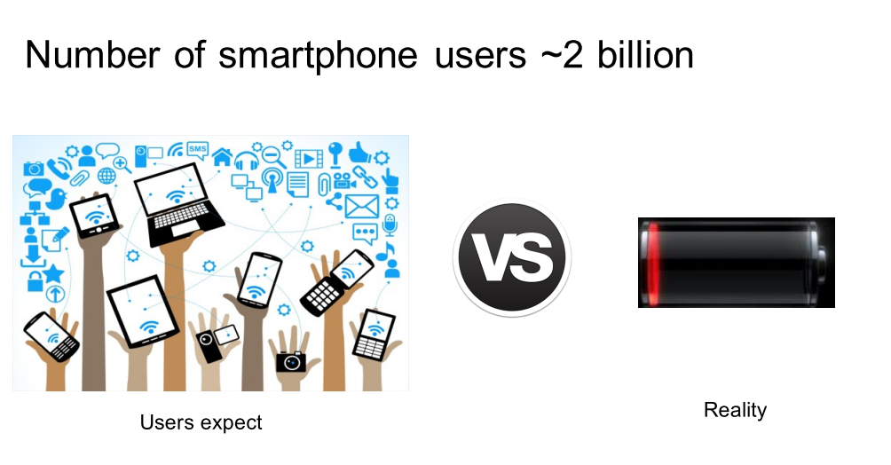
Motivation
Notes:
The number smartphones users is about 2 billions.
Users expects long operational time.
But unfurtunately, that’s not the case.
The run time depends on limited resource, and how the running app utilise the resource.

Slide 13
there is a simple solution
Genetic Improvement

Slide 14
there is a simple solution
Genetic Improvement

Slide 15
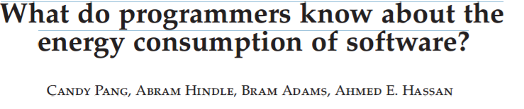
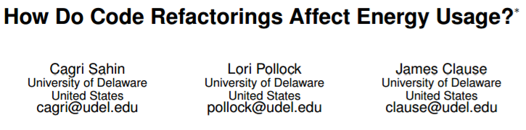
Motivation
Notes:
As it’s shown in couple of studies, developers lack knowledge about the best practices to reduce energy consumption of software, and are often unsure about how software consumes energy.
they usually optimise their apps according to other requirements such as the memory usage and performance.
2: conducted an empirical study to investigate the energy impacts of 197 applications of 6 commonly-used refactorings.
2: refactorings can not only impact energy usage but can also increase and decrease the amount of energy used by an application
2: metrics commonly believed to correlate with energy usage are unlikely to be able to fully predict the impact of applying a refactorin

Slide 16
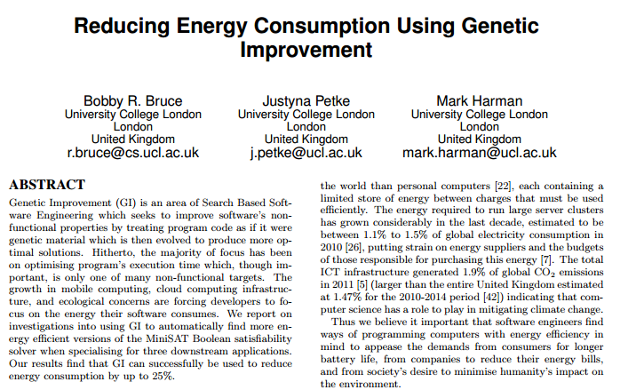
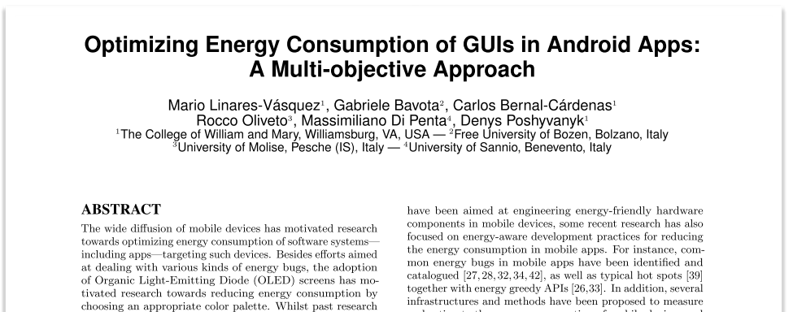
Related work
Notes:
1: Uses GI to improve a SAT solver but the work was done on a PC.
2: optimises the energy use of OLED screens on smartphones. The trade-off here is between energy, colors contrast and producing new GUI that have similar color set to the original one (to preserve the attractiveness).

Slide 17
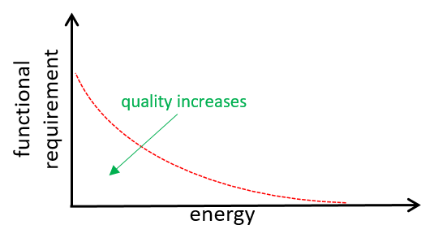
Methodology
Energy Measurement
External.
Internal. (5 years ago: very different)
Search Based Software Engineering
Solutions
No
Initialise population
Modification
Evaluation
Yes
Termination
Notes:
Energy Measurement is the act of obtaining energy consumption values
using speciﬁc hardware.
We have external HW and internal HW inside the phone.
External HW is accurate but expensive requires very high skills.
Internal is cheap and doesn’t require that much effort but has less accuracy.
SBSE: convert the SWE problem into search problem.
For the optimisation part: we look for the right configuration that make apps consume less energy.

Slide 18
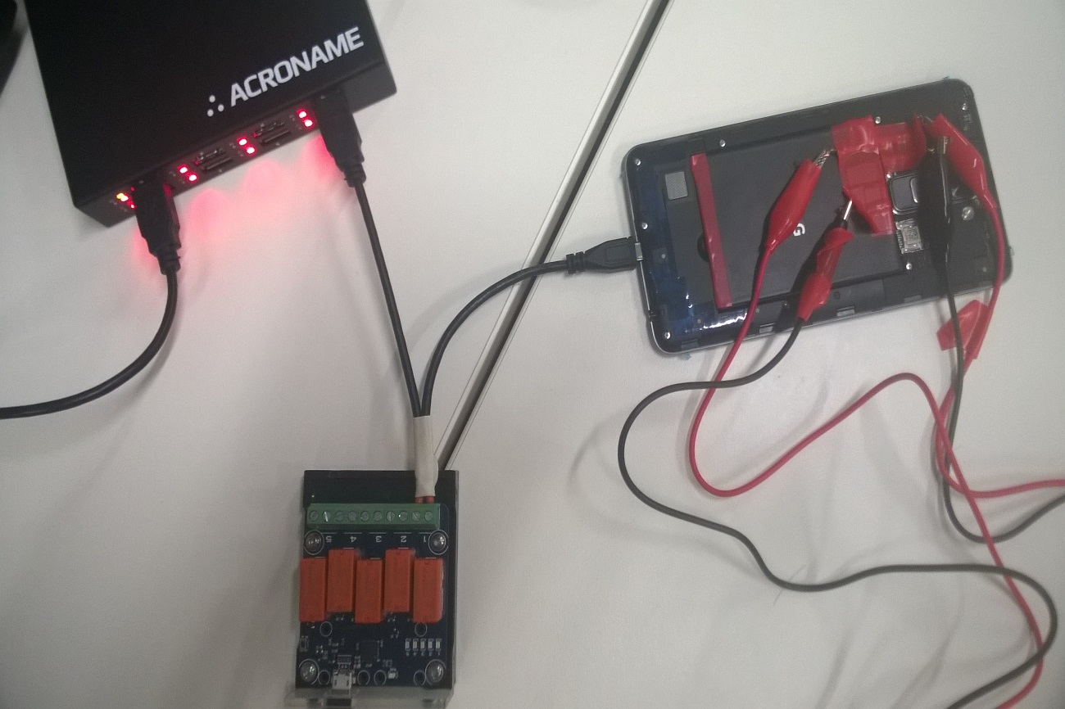
Internal vs. external
Summary of four experiments on two devices. CPU core speed was set at max frequency. Values are in Wh.
Experiment | Nexus 9 |  | Nexus 6
 | Internal | External | Internal | External
 | Total Energy measured in Wh
Screen on | 0.356 | 0.394 | 0.215 |  | 0.183
CPU | 0.068 | 0.074 | 0.034 |  | 0.030
Wi-Fi download | 1.571 | 1.699 | 0.526 |  | 0.514
4G download | 1.693 | 1.865 | 0.889 |  | 0.870
diff. range | -0.172 - -0.006 |  | +0.004 - +0.032
Notes:
AS can be seen here, Nexus 9 tends to underestimate the energy use, on the other hand n6 overestimates it.
Generally, there is a slight difference between both meters on each device.
Error rate
< -10
< +17

Slide 19
Target APP
Requirements:
Open source.
Widely used.
Energy-hungry app.
Test suite.
Notes:
Test cases results can deviates from the test oracle.
Rebound has 44 test cases.
For example when testing the motion of
Rebound library is used to simulate Spring animation in GUI of applications.
Spring: a resilient device, typically a helical metal coil, that can be pressed or pulled but returns to its former shape when released
testSpringMotionWithNoFriction
testSettingVelocityTriggersIteration

Slide 20
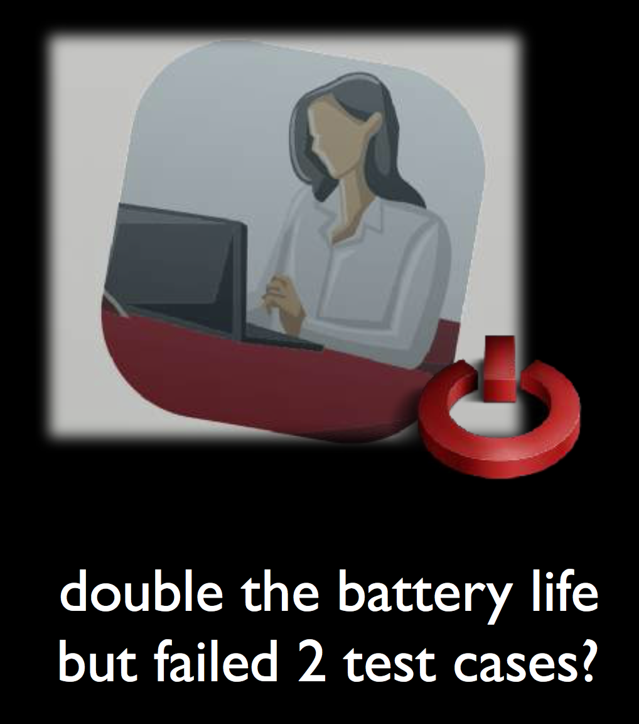

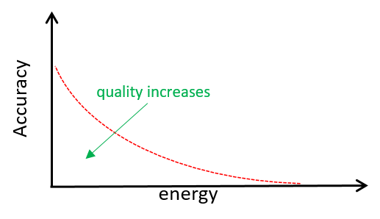



Target APP
Rebound Library:
Open source.
Widely used.
Energy-hungry app.
44 test cases.
Speed and position of springs.
LinkedIn
Evernote
Facebook Home
http://facebook.github.io/rebound/
Notes:
Test cases results can deviates from the test oracle.
Rebound has 44 test cases. Among the 44 test cases we found some test cases that tests speed and the position of the Spring.
For example when testing the motion of
Rebound library is used to simulate Spring animation in GUI of applications.
Spring: a resilient device, typically a helical metal coil, that can be pressed or pulled but returns to its former shape when released
testSpringMotionWithNoFriction
testSettingVelocityTriggersIteration

Slide 21
Framework
Deep Parameter Tuning. ➔ Parameter tuning of the physics calculations!
OS
Apps’ stats
Hardware Utilization
& app’s stats
App
App’
Config.csv
AppsProfiler.java
Offline modification
Optimiser.java
Parameter Extractor
Fitness values
Notes:
The main idea of deep parameter tunning is to expose parameters within the code to be optimised.
So The parameter extractor modifies the app source code in a way that makes it read its parameters values from a csv file.
Then the profiler collects the app and HW utilisation stats while the app is running. The profiler sends the fitness values to the optimiser. And then the optimiser generates new config files.

Slide 22
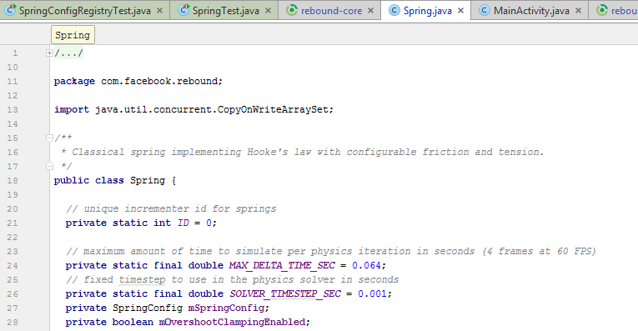
Framework
Deep Parameter Tuning. ➔ Parameter tuning of the physics calculations!
Notes:
The parameter extractor scans the source code files and identify all constants. It then extracts them and saves in a csv file with their initial values.
We are surfacing these parameters to find an improved configuration that uses less energy with minimum impact on the functional requirements.

Slide 23
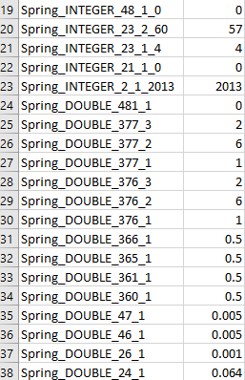
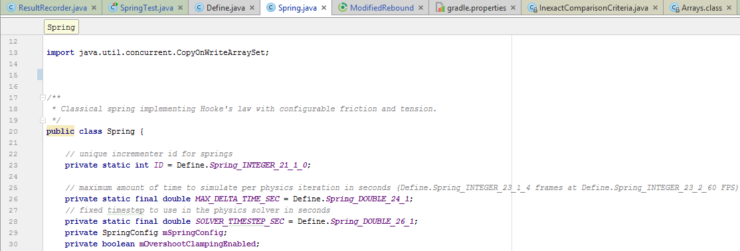
Framework
Deep Parameter Tuning. ➔ Parameter tuning of the physics calculations!
Notes:
As you can see here in line 24 we have exposed the MAX_Delta_time_sec data member and saves it into the csv file.

Slide 24
Method
Hardware
Utilization
data
Hardware Data: CPU freq., Screen brightness,
transmitted packets, signal strength …
36 dimensions
(CPU, Screen, Network)
Software data:
Apps utilisation.
Battery Fuel Gauge Chip (internal)
OS
Hardware Components (CPU, screen, Wi-Fi, 4G)
Settings
Battery stats
System Events and calls
Hardware
Utilization
data
Settings
BatteryMonitor.java
DataLogger.java
HardwareController.java
ModelGenerator.java

Slide 25
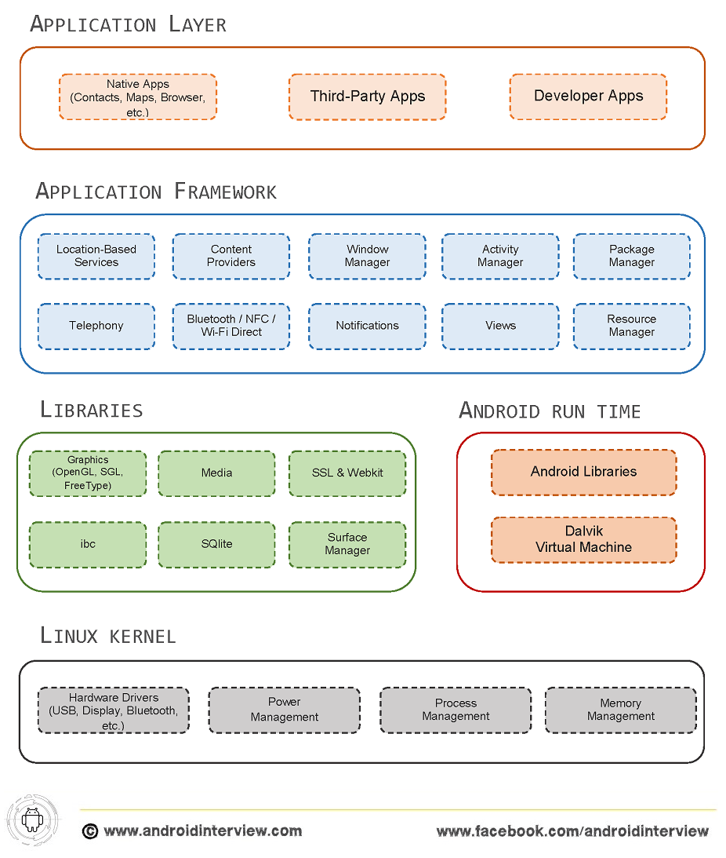
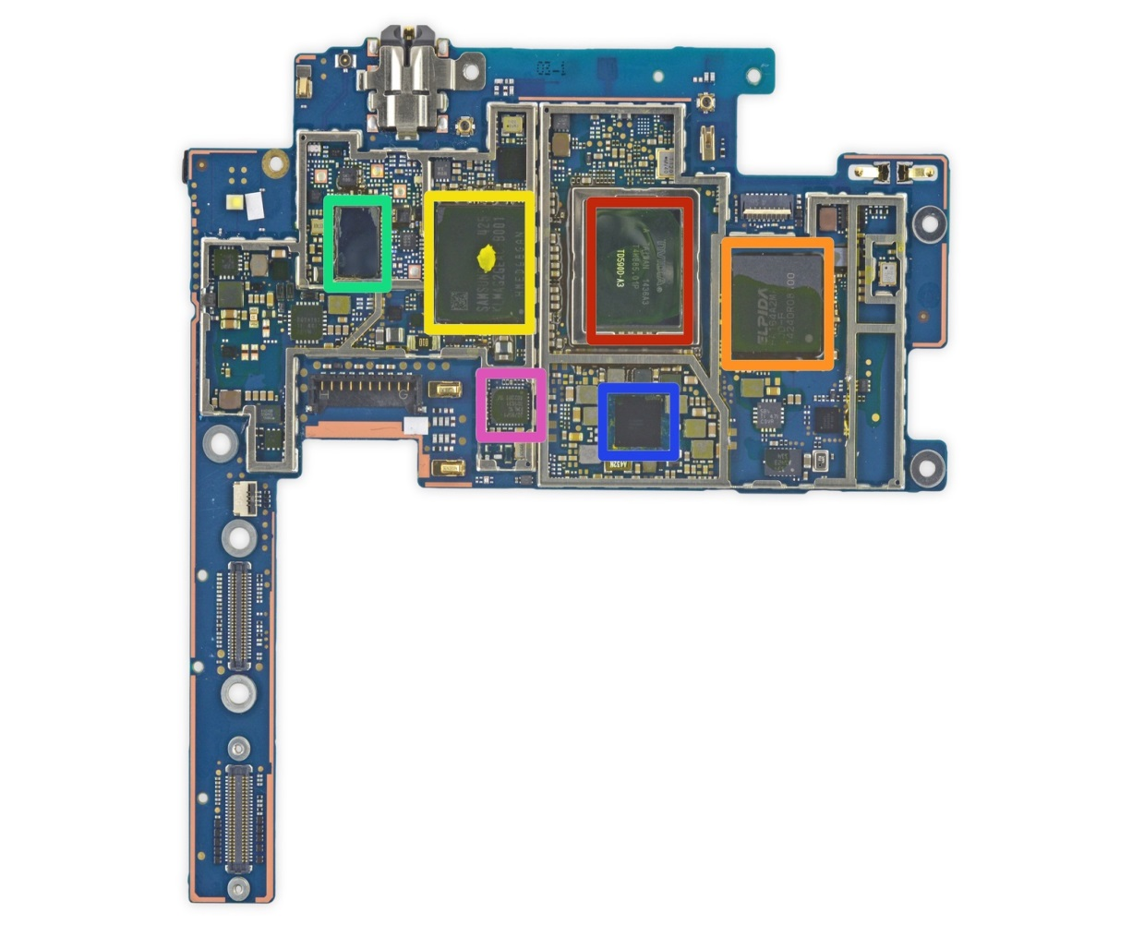
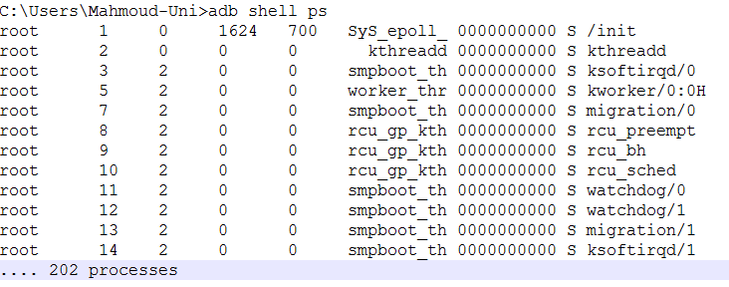
challenges
Noise.
System Architecture and Behaviour.
ifixit.com
Notes:
The energy readings is very noisy in smartphones and tablets which makes it hard to get an accurate evaluation of a solution.
The hardware components of the system has many communication interfaces, controller chips, multiple cpu cores. Isolating such components to reduce noise in energy readings is very difficult and almost impossible.
CPU frequency transitions overtime, Android has CPU governor that changes the cpu speed according to several pre-defined policies such as the current cpu workload.
The OS architecture is also complex and has many connection between its layers.
The background processes indeed share the energy resource and therefore they introduce noise to the solution under evaluation.

Slide 26
challenges
Noise.
System Architecture and Behaviour.
Solution.
Airplane mode.
Changing the CPU governor.
Fixing CPU frequency.
Turning the screen off.

Slide 27
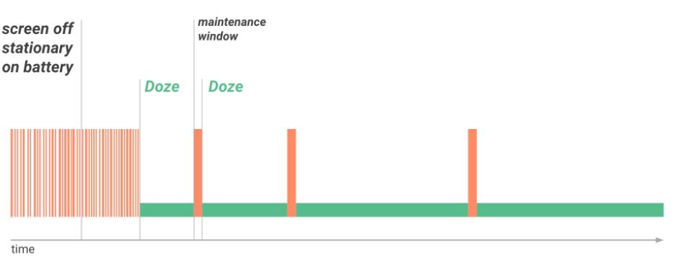
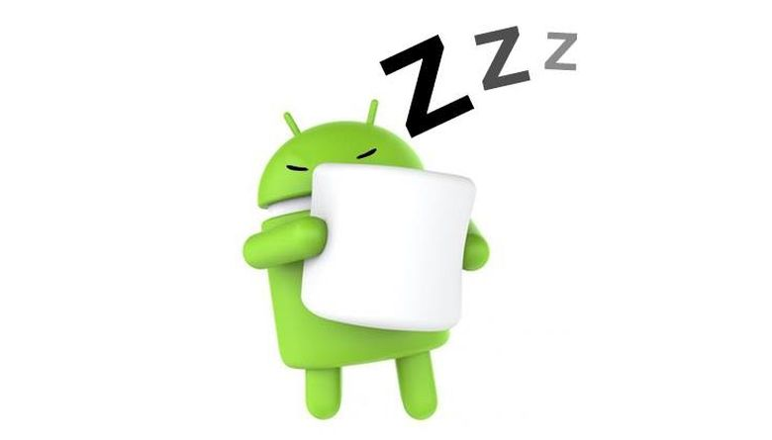
challenges
Noise.
System Architecture and Behaviour.
Doze Mode.
Notes:
Android doze mode is energy saving mechanism which suspends and reschedules background processes. When the screen is off, the system gets into this state (doze state) after a pre-defined period of time specified by each device manufacturer. This affects our datalogger and the app under test as we found that after about 20 minutes of starting the experiment the test execution time increased dramatically i.e. from seconds to several minutes.
The solution is to set an alarm which suspends the experiment, turns the screen on for 3.5 secs.
In addition, for our datalogger we use partial wakeslock which permits our app to use the cpu while the system is dozing.
***24-6-1:26 It seems I found another solution which requires modifying Rebound, (minimum changes) in a way that permits it to acquire partial wakelocks before running the test cases and release at the end. (not tested)

Slide 28

challenges
Noise.
System Architecture and Behaviour.
Doze Mode.
Solution.
Notes:
Android doze mode is energy saving mechanism which suspends and reschedules background processes. When the screen is off, the system gets into this state (doze state) after a pre-defined period of time specified by each device manufacturer. This affects our datalogger and the app under test as we found that after about 20 minutes of starting the experiment the test execution time increased dramatically i.e. from seconds to several minutes.
The solution is to set an alarm which suspends the experiment, turns the screen on for 3.5 secs.
In addition, for our datalogger we use partial wakeslock which permits our app to use the cpu while the system is dozing.
***24-6-1:26 It seems I found another solution which requires modifying Rebound, (minimum changes) in a way that permits it to acquire partial wakelocks before running the test cases and release at the end. (not tested)

Slide 29
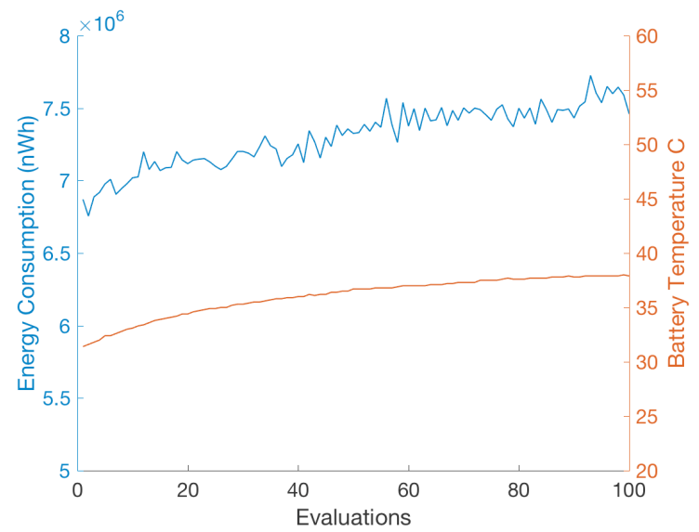
challenges
Noise.
Temperature.
Notes:
Temperature variations impact the energy use. At the beginning of the experiment it has no affects however, overtime we observed an increase in both temperature and energy.
This is extremely problematic in the context of evolutionary optimisation using NSGA-II.
The reason is:
At the beginning of the experiment the temperature of the device will be at room temperature. So early individuals will be on the Pareto frontier. Later on, as more populations run on the device, its temperature will increase which makes it really difficult for subsequent improved solutions to dominate the early individuals.

Slide 30
challenges
Noise.
Temperature.
Fridge.
Notes:
To overcome this problem we started by running the experiments inside the fridge to control the temperature. Unfortunately, it didn’t work, we actually we observed a really strange behaviour which was an inverse correlation between temperature and energy at some degrees.

Slide 31
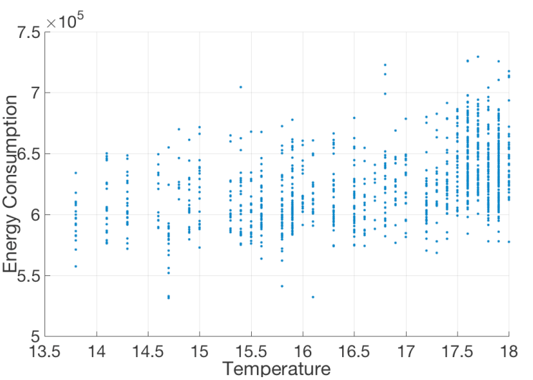
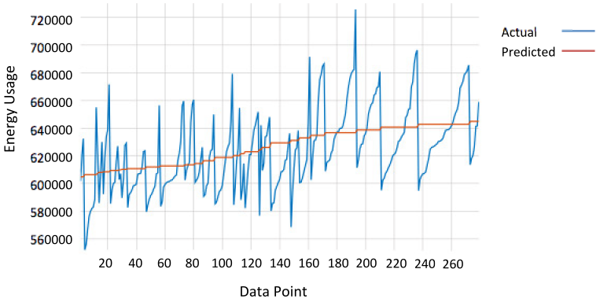
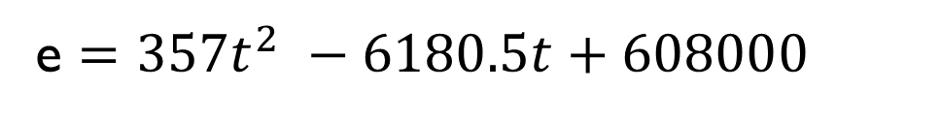
challenges
Noise.
Temperature.
Fridge.
Model & compensate?
e $={357t}^{2} −6180.5t+608000$
Notes:
So we moved on and tried to model the correlation between the temperature and energy use.
non-linear regression on the resulting data using the GPTIPS2, symbolic regression package.
Observe that there is large variance of energy consumption at each temperature level. The variance gets larger as the temp increases.

Slide 32
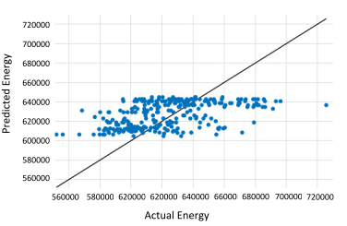
challenges
Noise.
Temperature.
Notes:
Fig 1. Nexus 6 and its readings come from two regimes/computation methods.

Slide 33
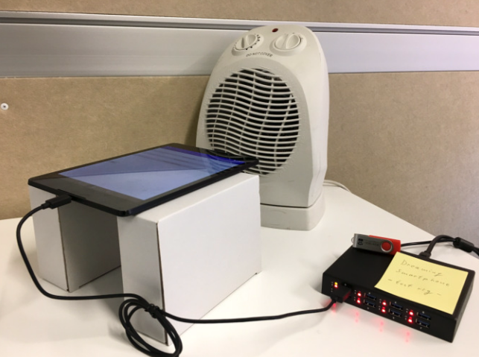
challenges
Noise.
Temperature.
Solution.
Notes:
The noisy solution!!!

Slide 34
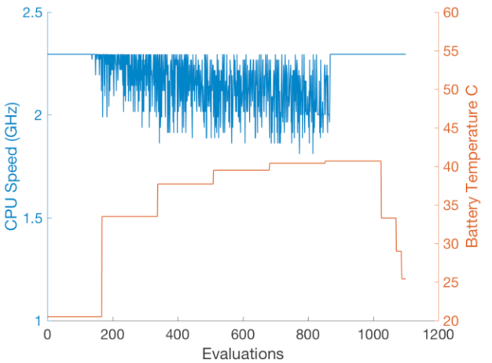
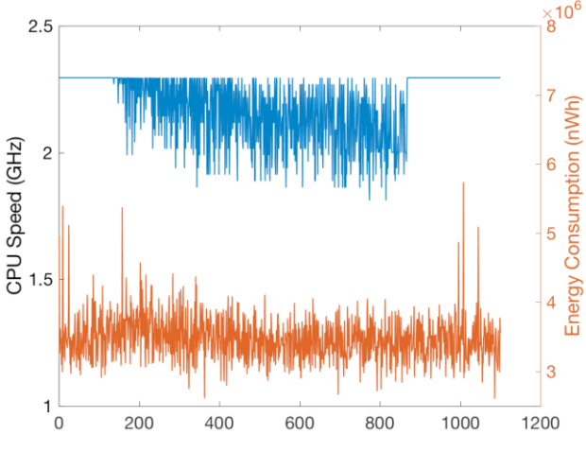
challenges
Noise.
CPU Throttling.
CPU Speed (GHz)
Evaluations
Notes:
When the temperature rises above 30C we noticed that the cpu frequency is reduced by thermal governor which we can’t control! As it shown in first plot
The second plot shows how this variation in speed affect the energy as well.

Slide 35
challenges
Noise.
CPU Throttling.
Solution.
Median frequency: 1.4 GHz.

Slide 36

challenges
Android Debug Bridge.
Deployment time.
Instability.
Connectivity Issues.
Notes:
Server, client and daemon. For establishing communication between PC and phones.
operations took up to a minute (best scenario) to complete, making iterative search impractically slow.
app transfer and installation could fail due to adb server instability.

Slide 37
Experiment setup
Population size: 20.
First population.
Generations: 17.
Objectives: Energy & Accuracy.
Timeout: 2 mins.
Recharge: 20 mins.
Measurement frequency: 4Hz.

Slide 38
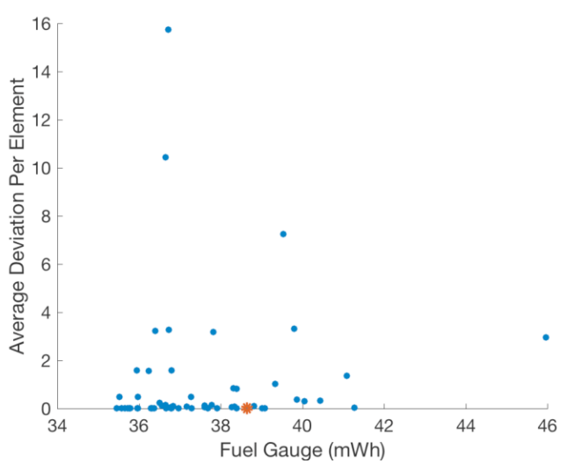
result
Orange: original configuration
Notes:
In total, the 56 solutions achieve 43 di#erent levels of accuracy.

Slide 39
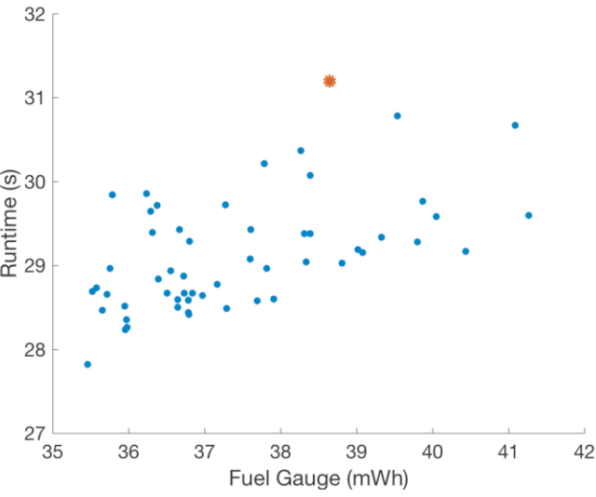
result
original configuration
Summary:
1 year of coding and learning
super “smart” OS and Android tools
internal sensor: super noisy in short evaluations, pretty good for longer evaluations

